Slide 1
ISO
international standard for financial transaction card originated interchange messaging

Slide 2
What is ISO ?
ISO is an international standard for financial transaction card originated interchange messaging. It is the International Organization for Standardization standard for systems that exchange electronic transactions initiated by cardholders using payment cards.
ISO 8583 defines a message format and a communication flow so that different systems can exchange these transaction requests and responses. The vast majority of transactions made when a customer uses a card to make a payment in a store (EFTPOS) use ISO 8583 at some point in the communication chain, as do transactions made at ATMs. In particular, the Mastercard, Visa and Verve networks base their authorization communications on the ISO 8583 standard, as do many other institutions and networks.
Although ISO 8583 defines a common standard, it is not typically used directly by systems or networks. It defines many standard fields (data elements) which remain the same in all systems or networks, and leaves a few additional fields for passing network-specific details. These fields are used by each network to adapt the standard for its own use with custom fields and custom usages like Proximity Cards.

Slide 3
Introduction
The ISO 8583 specification has three parts
Part 1: Messages, data elements, and code values
Part 2: Application and registration procedures for Institution Identification Codes (IIC)
Part 3: Maintenance procedures for the aforementioned messages, data elements and code values

Slide 4
ISO message is made of the following parts
Message type indicator (MTI).
primary bitmap and secondary bitmap.
Data elements, the actual information fields of the message.

Slide 5
MTI (Message type indicator)
The message type indicator is a four-digit numeric field which indicates the overall function of the message.
The first digit of the MTI indicates the ISO version in which the message is encoded.
Position two of the MTI specifies the overall purpose of the message.
Position three of the MTI specifies the messages function which defines how the message should flow within the system.
Position four of the MTI defines the location of the message source within the payment chain.

Slide 6
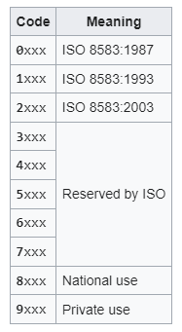
The first digit of the MTI indicates the ISO version in which the message is encoded.

Slide 7
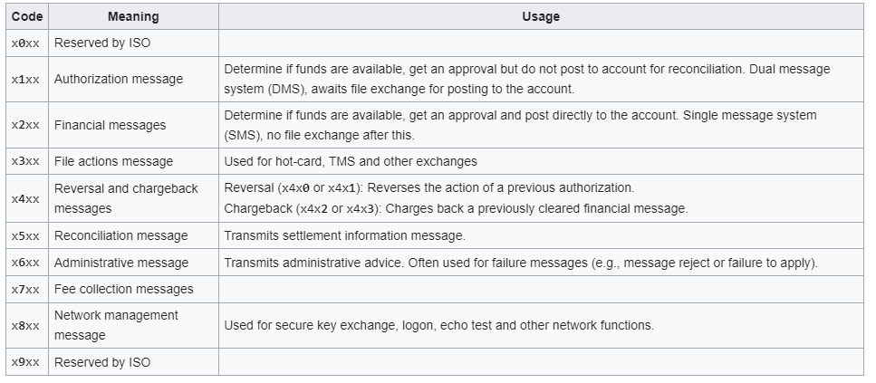
Position two of the MTI specifies the overall purpose of the message.

Slide 8
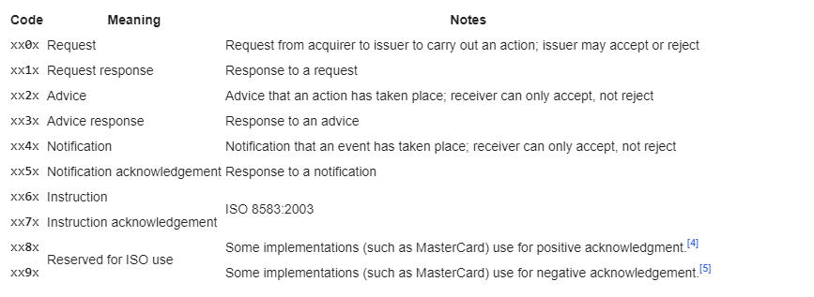
Position three of the MTI specifies the messages function which defines how the message should flow within the system.

Slide 9
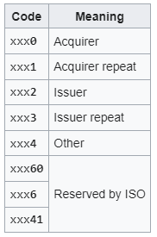
Position four of the MTI defines the location of the message source within the payment chain.

Slide 10
Examples
Given an MTI value of 0110, the following example lists what each position indicates:
0xxx → version of ISO 8583 (0 = 1987 version)
x1xx → class of the message (1 = authorization message)
xx1x → function of the message (1 = response)
xxx0 → who began the communication (0 = acquirer)

Slide 11
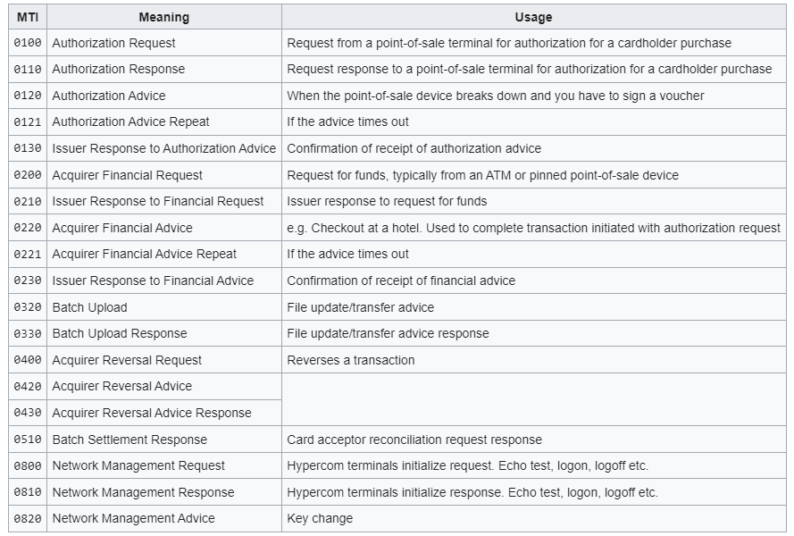

Slide 12
Bitmaps
In ISO 8583, a bitmap is a field or subfield within a message, which indicates whether other data elements or data element subfields are present elsewhere in the message.
A field is considered to be present only when the corresponding bit in the bitmap is set. For example, a hex with value 0x82 (decimal 130) is binary 1000 0010, which means fields 1 and 7 are present in the message and fields 2, 3, 4, 5, 6 and 8 are not.
The bitmap may be represented as 8 bytes of binary data or as 16 hexadecimal characters (0–9, A–F) in the ASCII or EBCDIC character sets. A message will contain at least one bitmap, called the primary bitmap, which indicates data whether elements 1 to 64 are present. The presence of an optional secondary bitmap is also indicated by the first bit in the primary bitmap. If present, the secondary bitmap indicates whether data elements 65 to 128 are present. Similarly, a tertiary bitmap can be used to indicate the presence of fields 129 to 192, although these data elements are rarely used.

Slide 13
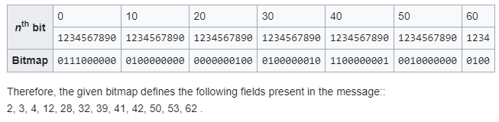
Examples
Given a bitmap value of 70 10 00 11 02 C0 48 04,
0x70 = 0111 0000 (counting from the left, the second, third and fourth bits are 1, indicating that fields 2, 3 and 4 are present)
0x10 = 0001 0000 (the first bit corresponds to field 9, so the fourth bit here indicates field 12 is present)
0x00 = 0000 0000 (no fields present)
0x11 = 0001 0001 (fields 28 and 32 are present)
0x02 = 0000 0010 (field 39 is present)
0xC0 = 1100 0000 (fields 41 and 42 are present)
0x48 = 0100 1000 (fields 50 and 53 are present)
0x04 = 0000 0100 (field 62 is present)

Slide 14
Data elements
Data elements are the individual fields carrying the transaction information. There are up to 128 data elements specified in the original ISO 8583:1987 standard.
While each data element has a specified meaning and format, the standard also includes some general purpose data elements and system- or country-specific data elements which vary enormously in use and form from implementation to implementation.

Slide 15
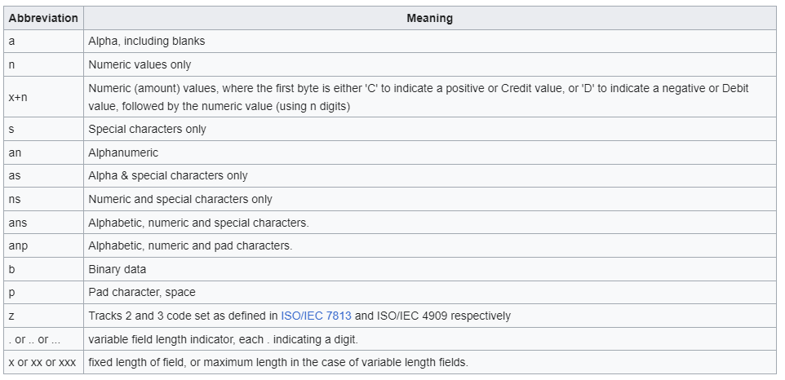
Each data element is described in a standard format which defines the permitted content of the field (numeric, binary, etc.) and the field length (variable or fixed),

Slide 16
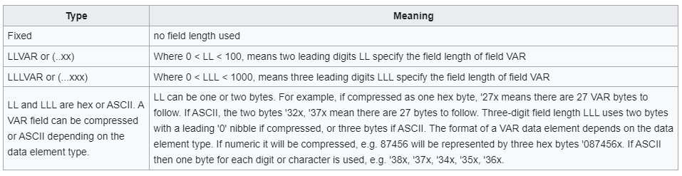
Additionally, each field may be either fixed or variable length. If variable, the length of the field will be preceded by a length indicator.

Slide 17
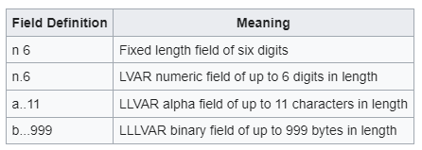
Examples

Slide 18
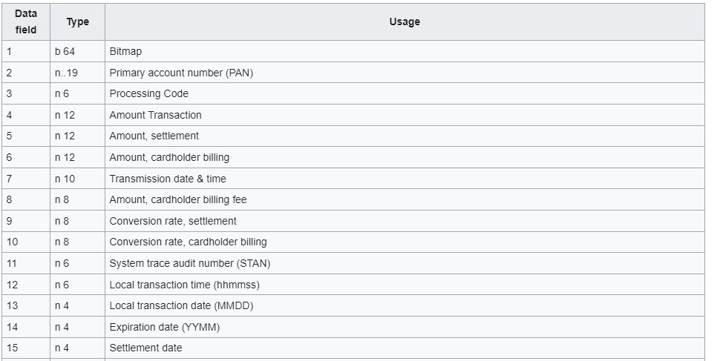
ISO-defined data elements

Slide 19
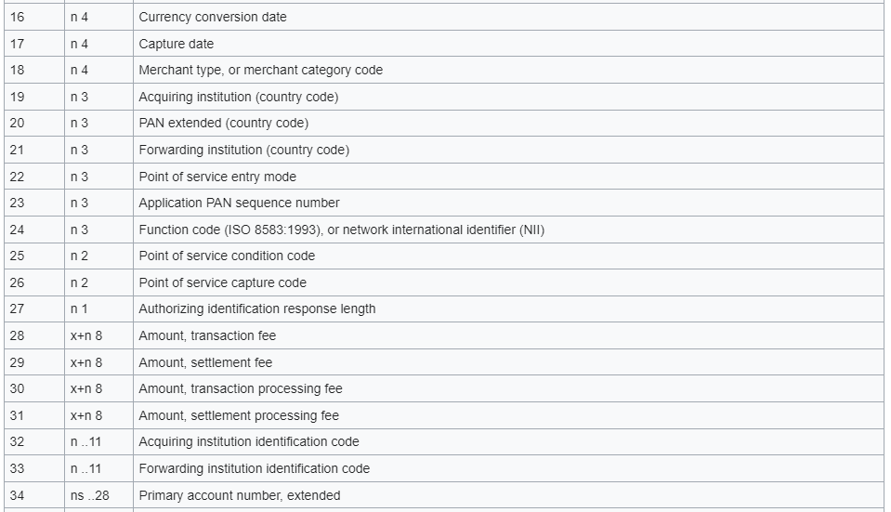

Slide 20
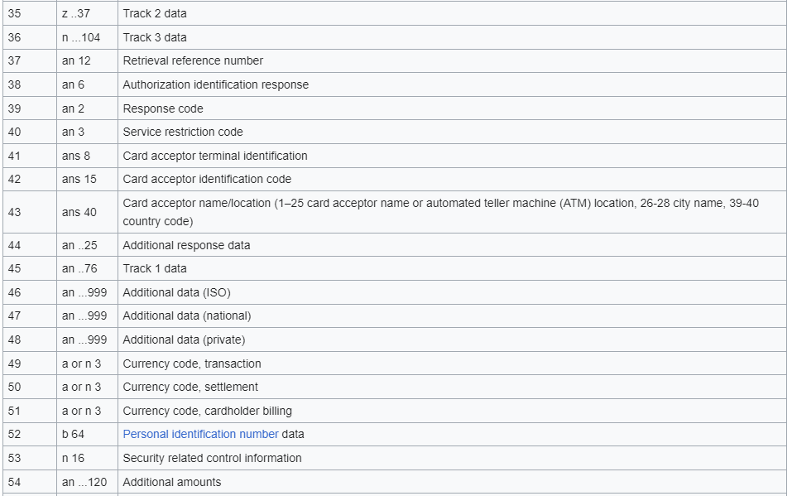

Slide 21
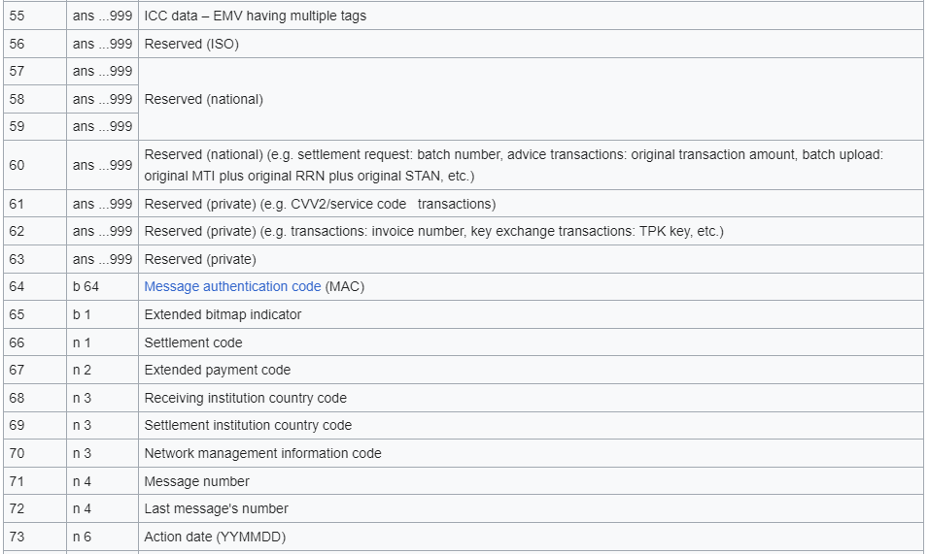

Slide 22
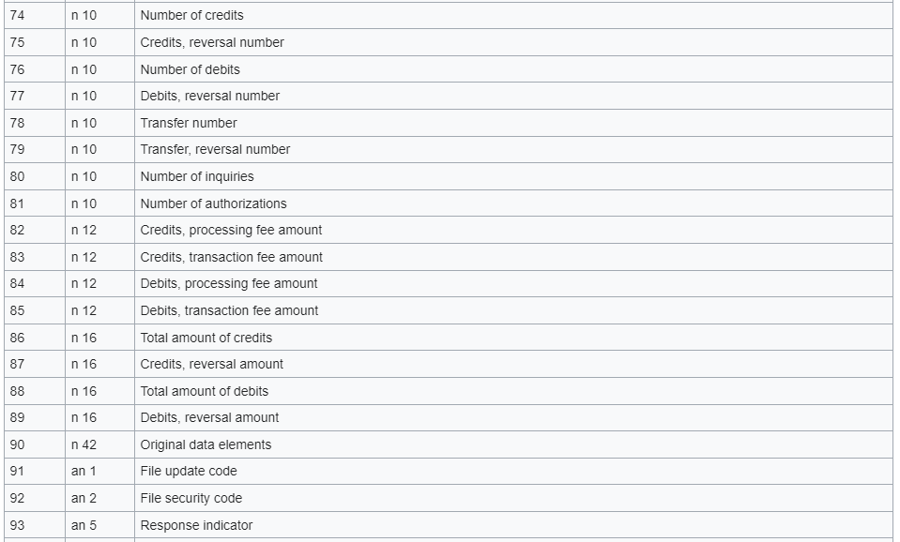

Slide 23
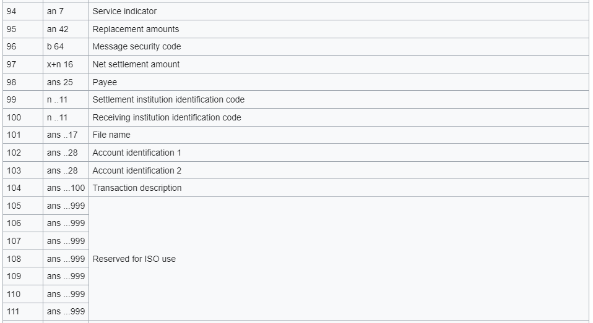

Slide 24
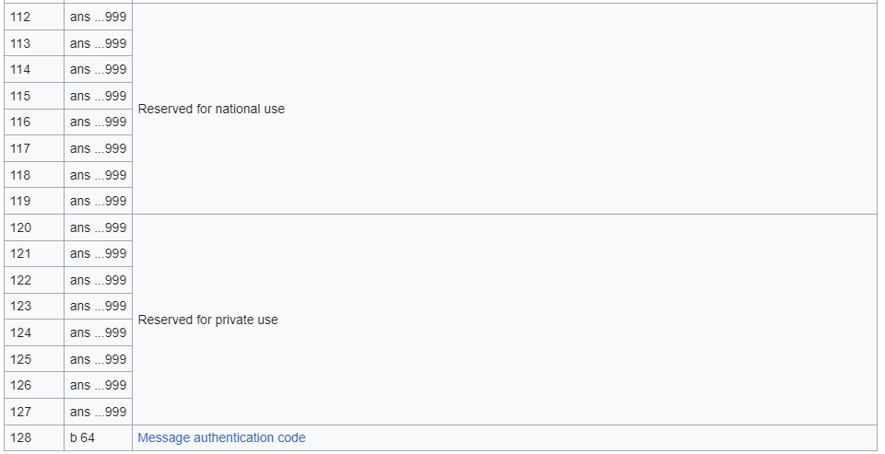

Slide 25
Thank You.

